Slide 1
Outcomes-based commissioning: How social enterprise accreditation can help

Slide 2
The context
Public sector commissioning landscape is undergoing substantial changes;
Budgets are tighter than ever
Maintaining public confidence and positive perceptions is constant challenge, which needs careful management if initiatives are to be delivered successfully

Slide 3
The context
Positive social and environmental outcomes are a strong motivator in decision making
“Sustainability”, “social value”, “social impact”; it’s all about the same thing – delivering over and above the core service.
For example, creating additional jobs, enhancing skills, and reducing homelessness….the list goes on!

Slide 4
The challenges you face
The Public Services (Social Value) Act:
Increasing pressure for public services that deliver lasting social outcomes
= how do you know that service providers will actually deliver the added social outcomes they say they will?

Slide 5
The solution
The Social Enterprise Mark and Social Enterprise Gold Mark can help you to look beyond the motivations of immediate short term cuts

Slide 6
The solution
Ask for the Social Enterprise Gold Mark in your criteria:
Ensure that a service provider is not only outcomes-focused, but also has the ability, track record, capacity, and future plans to consistently deliver social value

Slide 7
The solution
Ask for the Social Enterprise Mark:
Externally assessed guarantee of a providers’ commitment to maximising income and allocating profits towards achieving wider social outcomes.

Slide 8
What is the Social Enterprise Gold Mark?
Enhanced accreditation demonstrating excellence across key business areas
A quality indicator
Organisations awarded the Gold Mark have proven their capacity to deliver social value/impact
Continuous improvement tool

Slide 9
What is the Social Enterprise Mark?
Unique social enterprise accreditation, enabling credible social enterprises to prove they trade to create benefits for people and the planet
License acts as guarantee that an organisation commits a majority of profits to defined social purposes
Organisations awarded the Social Enterprise Mark have met a baseline measure to demonstrate social value

Slide 10
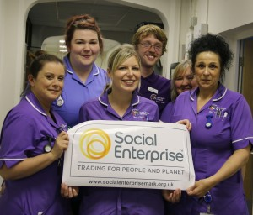
Ask for the Social Enterprise Mark and Social Enterprise Gold Mark in your commissioning criteria

Slide 11
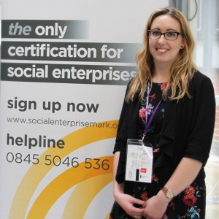
Find out more:
Search for accredited social enterprises:
http://www.socialenterprisemark.org.uk/directory-certified-social-enterprises/
Or ring our helpline:
 0345 504 6536

